Slide 1

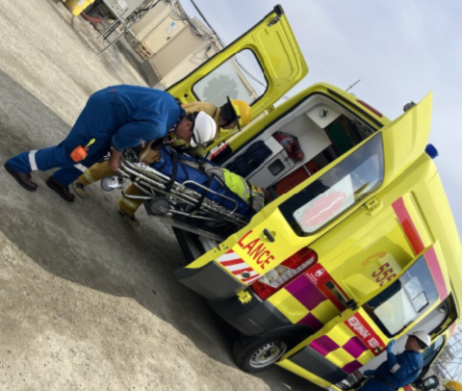
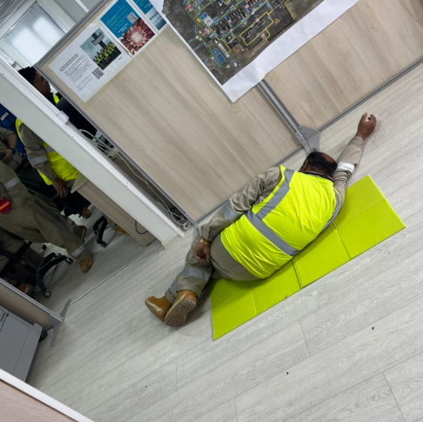
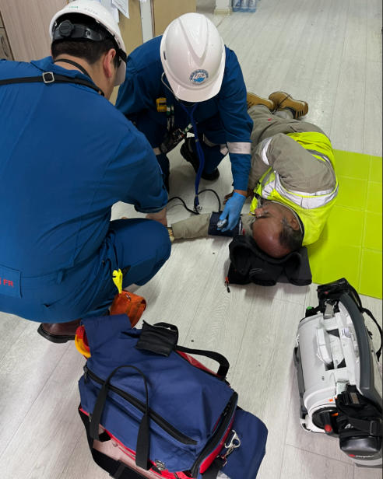
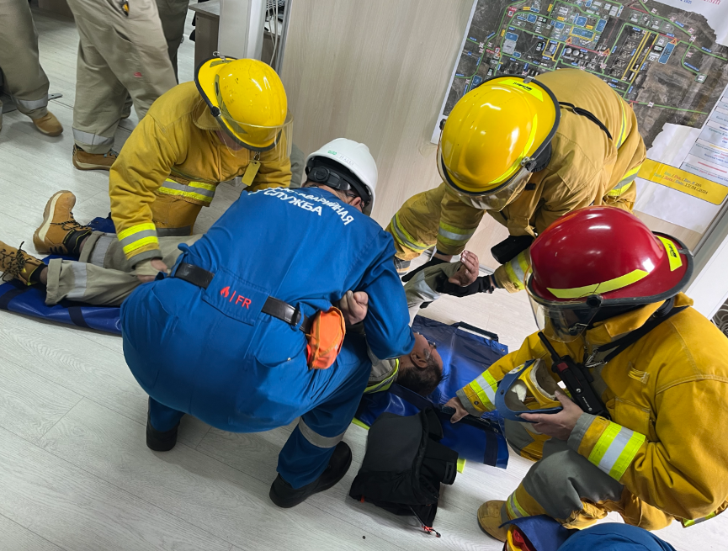
WoodKSS May 2024 HSSE Dashboard
Achieved 1,223,043 Man-hours LTI Free
Manhours | Month | YTD | LTI Free | PoB
Atyrau Corporate | 8,574 | 45,147 | 5,327.404 | 57
FGP MAC | 39,801 | 146,328 | 582,364 | 125
TCO EMC | 6,689 | 31,585 | 1,175,010 | 50
Total Dunga | 2,091 | 9,149 | 245,140 | 9
GSU | 20,097 | 87,237 | 138,114 | 122
KTL KSU | 12,348 | 60,454 | 341,437 | 71
WOODKSS Atyrau | 44.559 YTD (km)
FGP MAC | 225.374 YTD (km)
Totals 269.933 YTD 2024
Cum: | 89,600 | 379,900 | 7,809,469 | 434
FGP MAC MEDICAL DRILL ON TENGIZ
Leading Indicators (progress against target) |  |  |  | Lagging Indicators
 | Target | Month | YTD |  | Month | YTD
Leadership Engagement – Managers & PM | 1 per Q - 53 | 2 | 35 | Lost Time Incident Rate (LTIR) | 0 | 0
HSSE Assurance (as per ATRACK system) | 4 | 0 | 1 | Total Recordable Incident Rate (TRIR) | 0 | 0
Number of Safety Observation (Client) | 1 per month | 374 | 1984 | High Potential (HIPO) | 0 | 0
Internal Observations HEART | 1 per month | 19 | 62 | Motor Vehicle Accident (MVA) | 0 | 0
ER/BCP Drill – Exercise | 8 | 0 | 1 | Medical Treatment Case (MTC) | 0 | 0
Life Saving Rules – Safety Critical Inspections | 50 | 5 | 29 | First Aid Case (FAC) | 0 | 0
WoodKSS Safety Committee Meeting | 6 | 0 | 1 | Near Miss Incident (NM) | 1 | 1
Internal Communication | 12 | 3 | 8 | Occupational Health Illness | 0 | 0
Strategic Commentary
Kazakhstan Leadership Engagements: 40 leadership engagements have been completed, 34 of them by WoodKSS management;
WoodKSS Business Trips process: BTRF has been revised and issued as Rev5;
Tengiz activities: On May 17, Medical Drill took place; MAC IIF Champions' Lunch with TCO Management on 24th of May; Integrated 3GP IIF Champions Lunch on May 29; Monthly OELT meeting; Teapot Talk Execution on May, 19;
Security Training completion percentage of WoodKSS is 99%;
Online LSR training is ongoing – 93% (374 employees completed LSR training);
WOODKSS Road Safety performance review on weekly basis;
Monthly HSSES Performance Report and LPI report has been submitted;
WoodKSS Building Elevators: Landlord confirmed payment of new elevators, Fuji elevators will be installed. Old elevators removal in progress;
WoodKSS monthly Safety Inspection has been completed, 11 findings reported;
Communication: 3 safety topics were distributed;
Incident Log
Date | Company | Project | Location | Type of Incident | Brief Description | Actual / Potential Risk | Status of Incident Investigation
NO CASES WERE REGISTERED IN MAY 2024 | WoodKSS | Atyrau Corporate | WoodKSS office, 3rd floor. #310 | Injury | On 05.02.2024 approx.12.30am, steel profile fell from the ceiling in the WoodKSS office #310 and landed on the desk, where individual was sitting at the time. No harm to the people. | A1 / B1 | Ongoing

